Slide 1
Efficient Gradient Estimation for Overparameterized Stochastic Differential Equations
Shengbo Wang¹
Joint work with Jose Blanchet² and Peter Glynn²
¹Daniel J. Epstein Department of Industrial and Systems Engineering, USC
²Management Science and Engineering, Stanford University
This work is supported generously by NSF 1915967, 2118199, 2229012, 2312204, 2312205, and Air Force Office of Scientific Research FA9550-20-1-0397.

Slide 2
Motivation

Slide 3
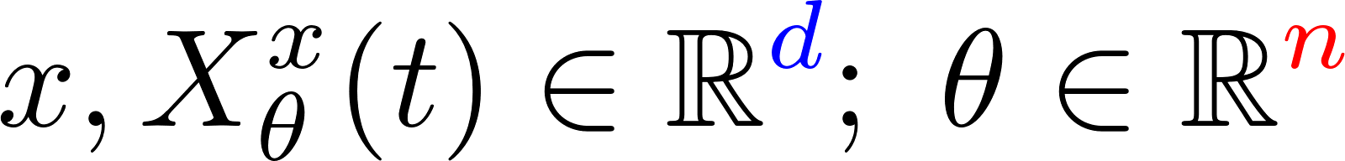
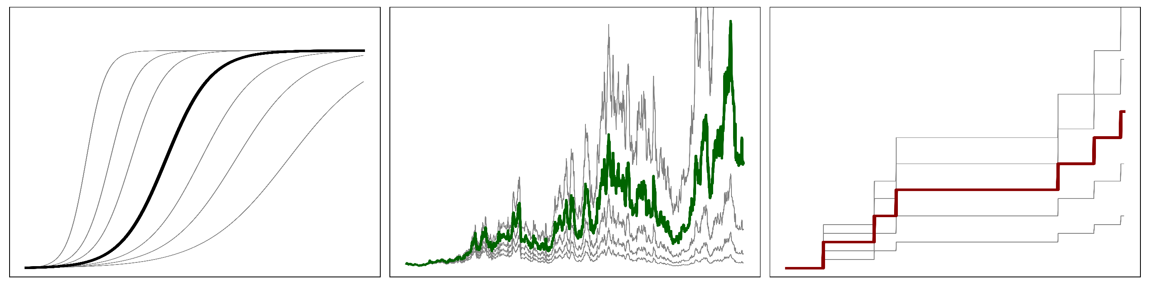
Parameterized SDEs
Continuous time stochastic system modeling with parameterized stochastic differential equation (SDE) with jumps
ODEs
Continuous Diffusions
Pure Jump Processes

Slide 4

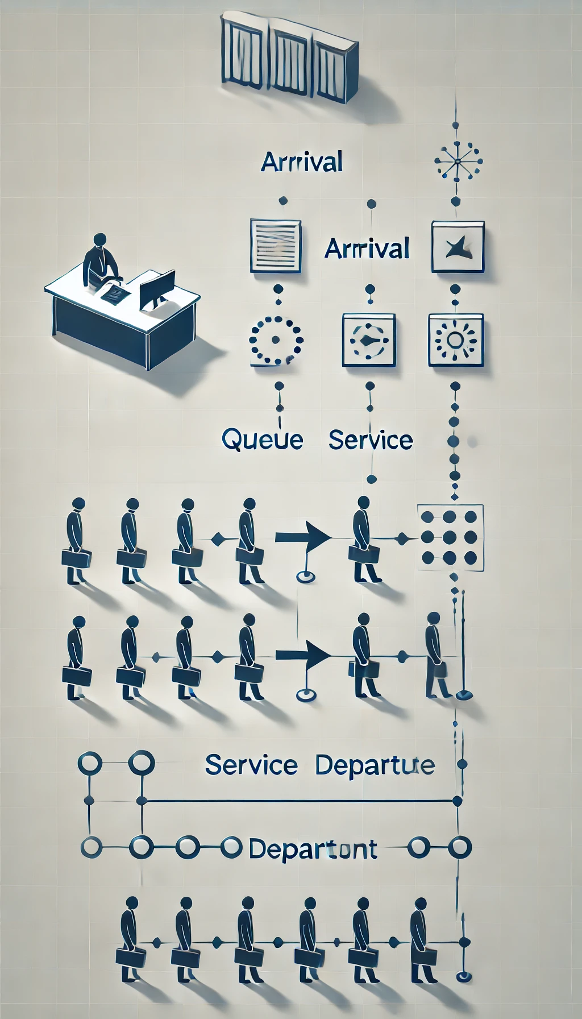
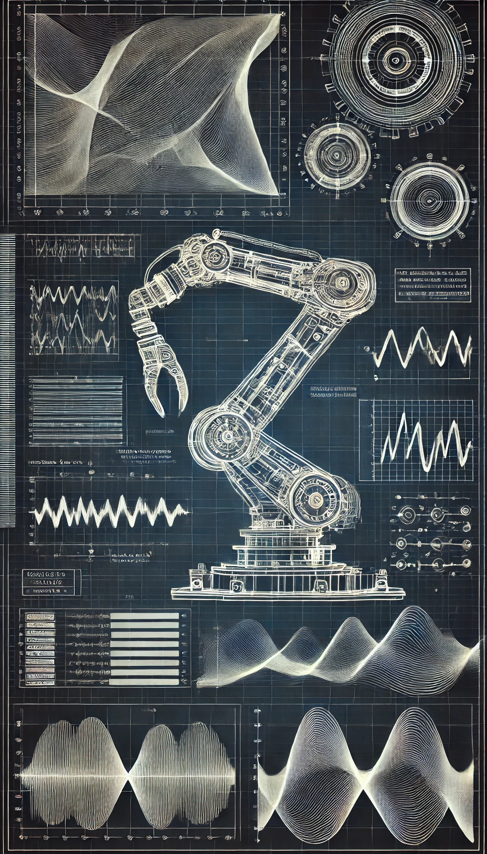
Managerial and Engineering Applications
……
Financial Engineering
Queueing System
Stochastic Control
Generative AI

Slide 5
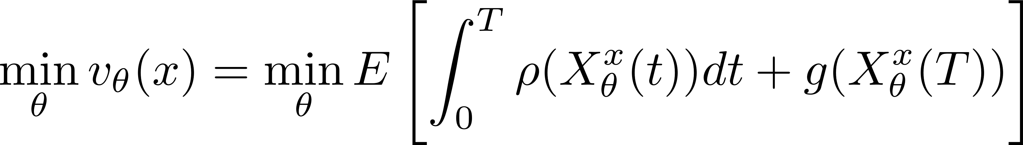

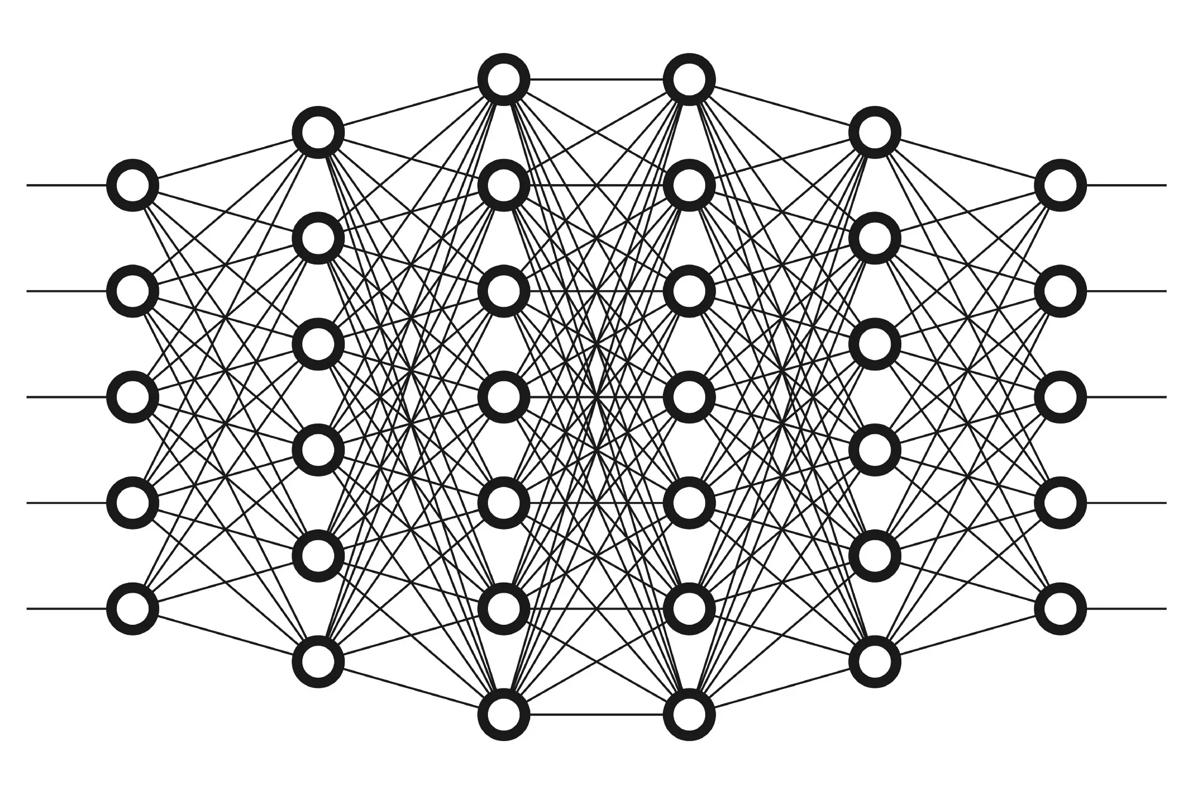
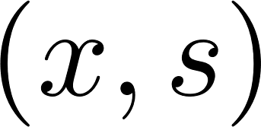
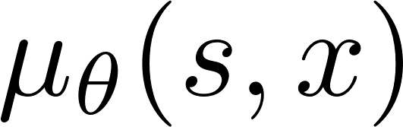
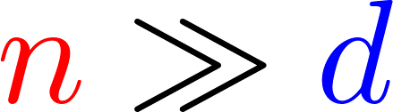
Formulation
Contemporary settings:
Overparameterization

Slide 6
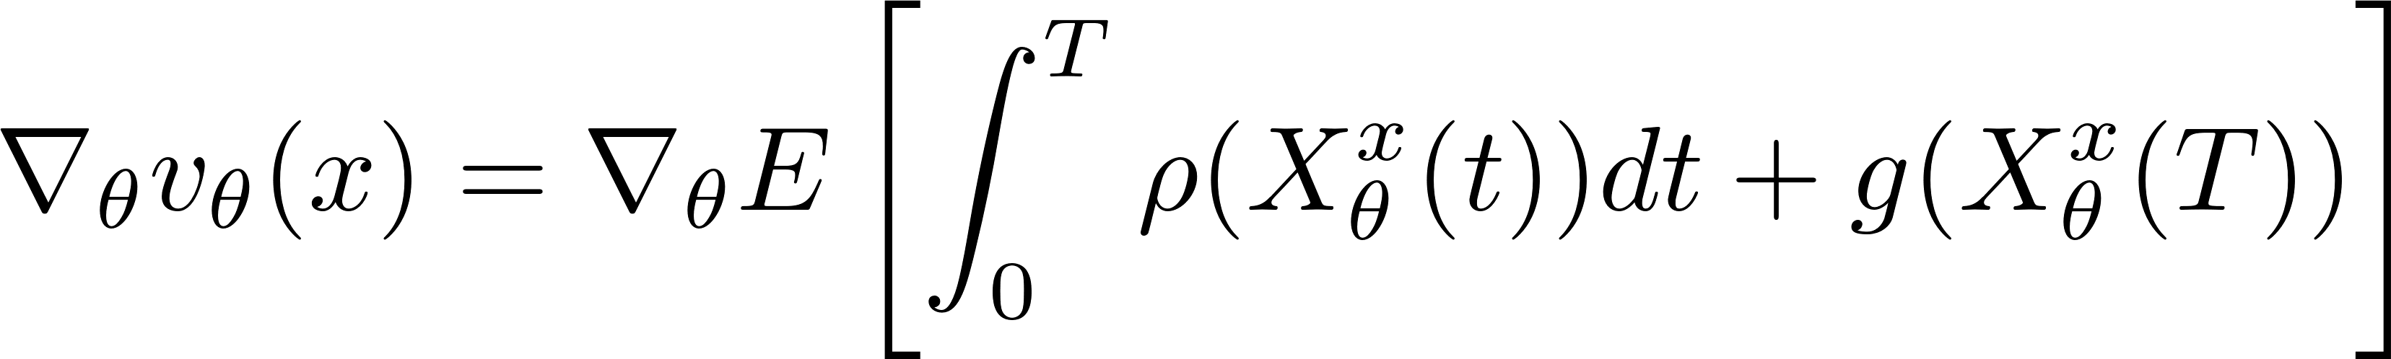
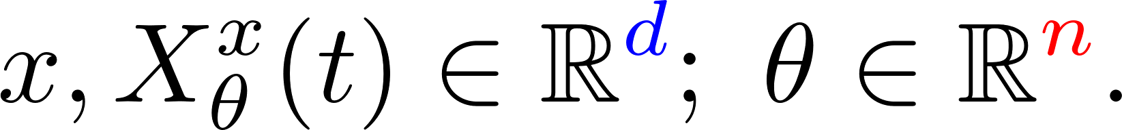
Optimizing Overparameterized SDEs
Goal:
Efficient stochastic gradient estimation
in this overparameterized setting

Slide 7
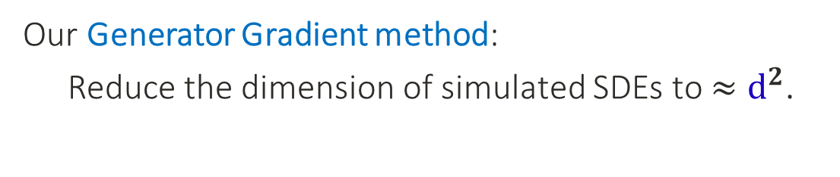

Optimizing Overparameterized SDEs
Challenge for standard methods:
Stochastic gradient estimation involves
simulating SDEs of dimension $≈n$.
Our Generator Gradient method:
Reduce the dimension of simulated SDEs to $≈d^{2}$.

Slide 8
Methodology

Slide 9
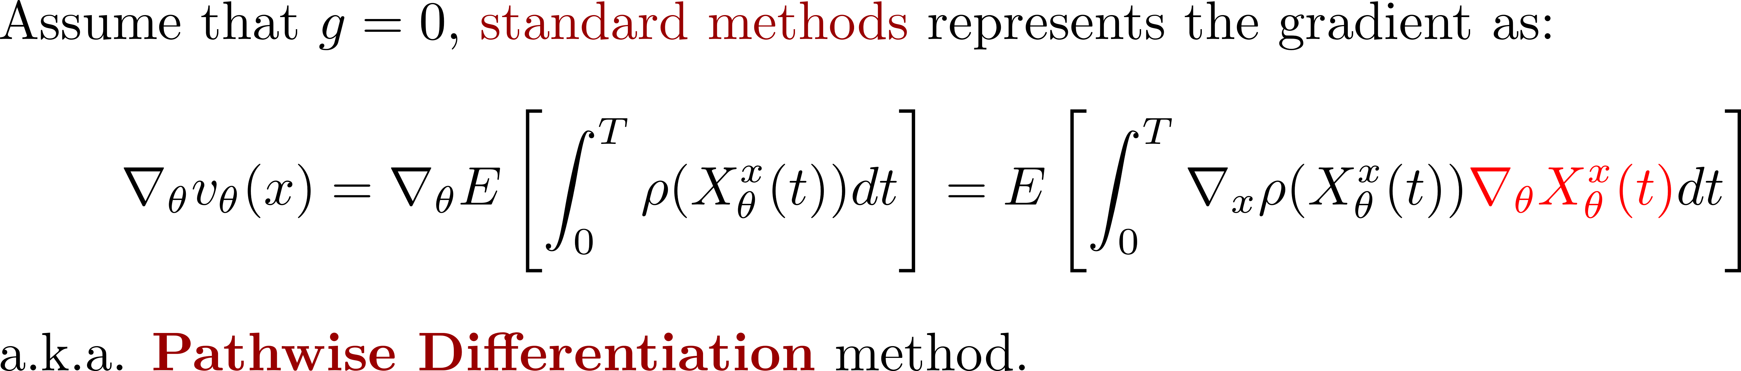
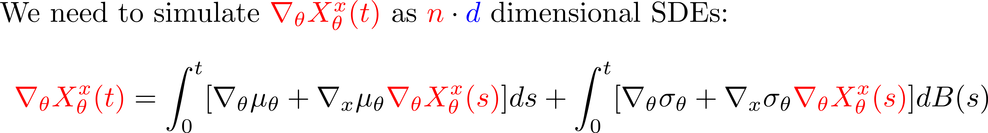
Computation Challenge

Slide 10
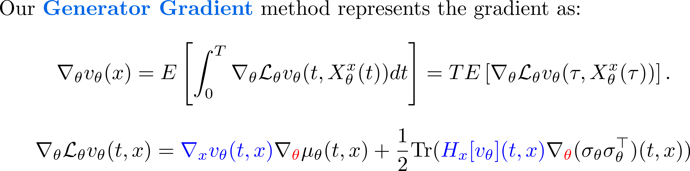
The Generator Gradient Estimator

Slide 11
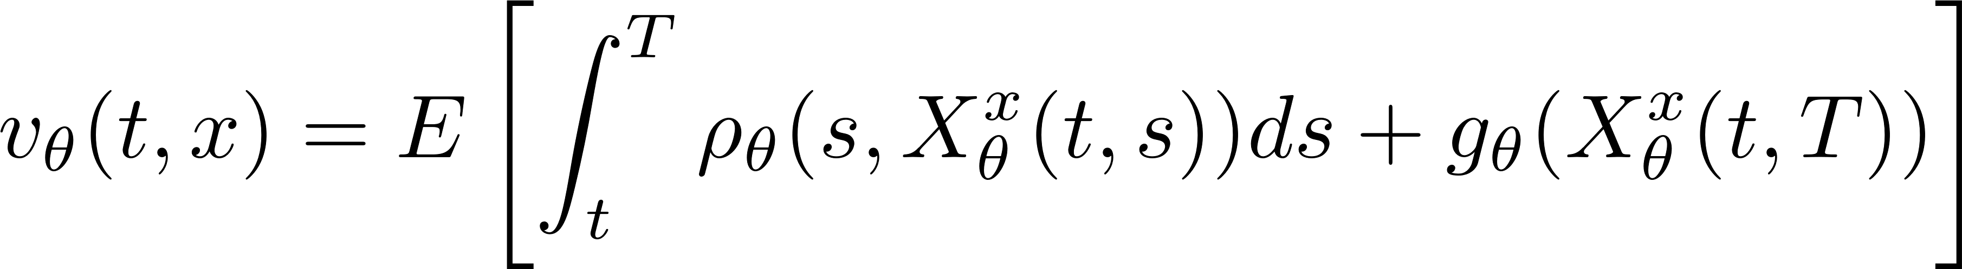
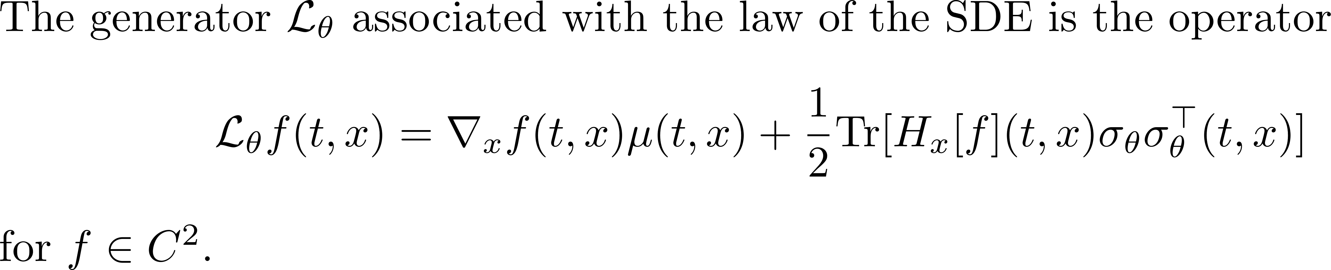
Formulation

Slide 12
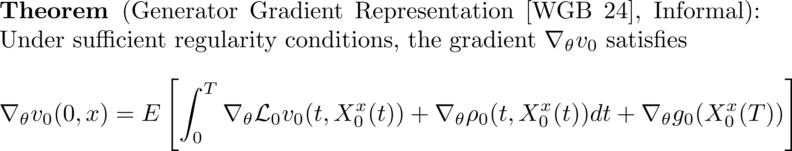
Probabilistic Representation

Slide 13
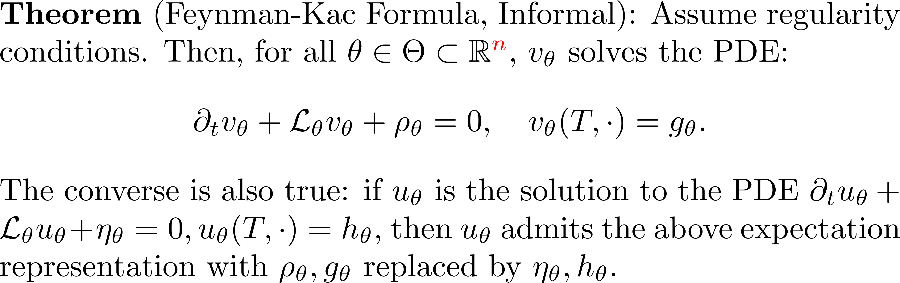
The Feynman-Kac Formula

Slide 14
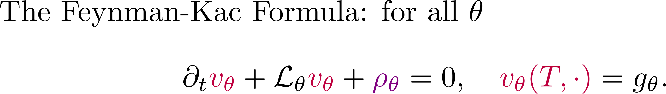
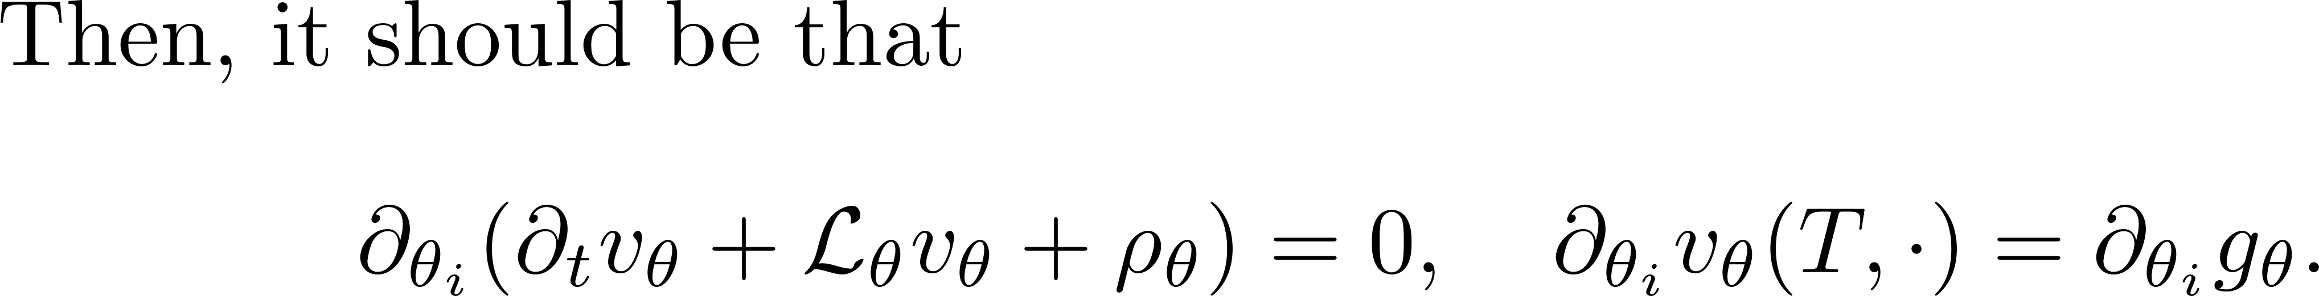
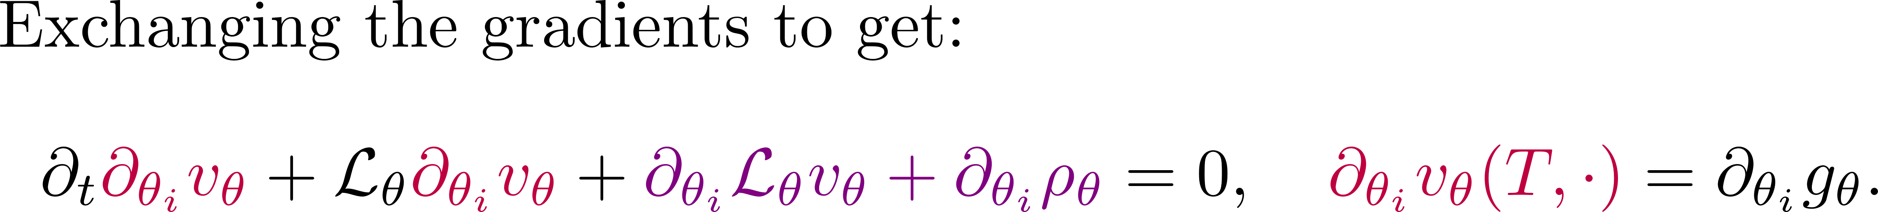
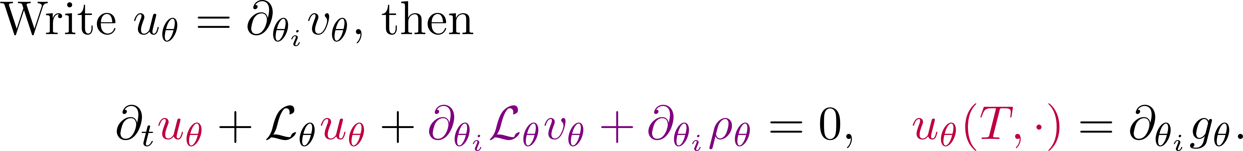
Differentiating the Feynman-Kac Formula

Slide 15
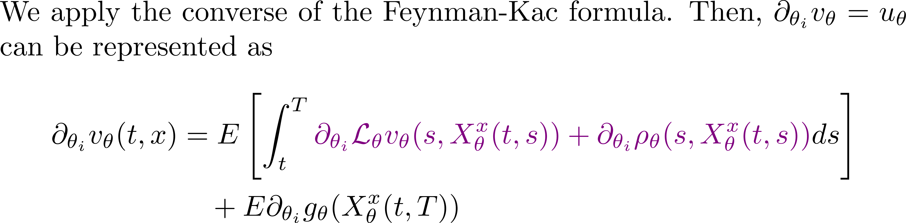
Apply the Converse

Slide 16
Probabilistic Representation

Slide 17
Empirical validation

Slide 18
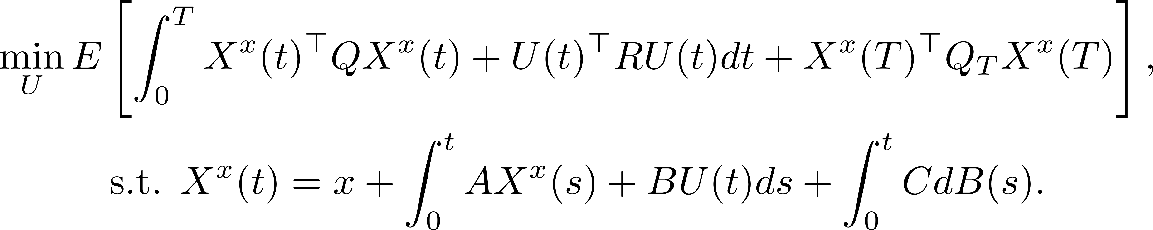
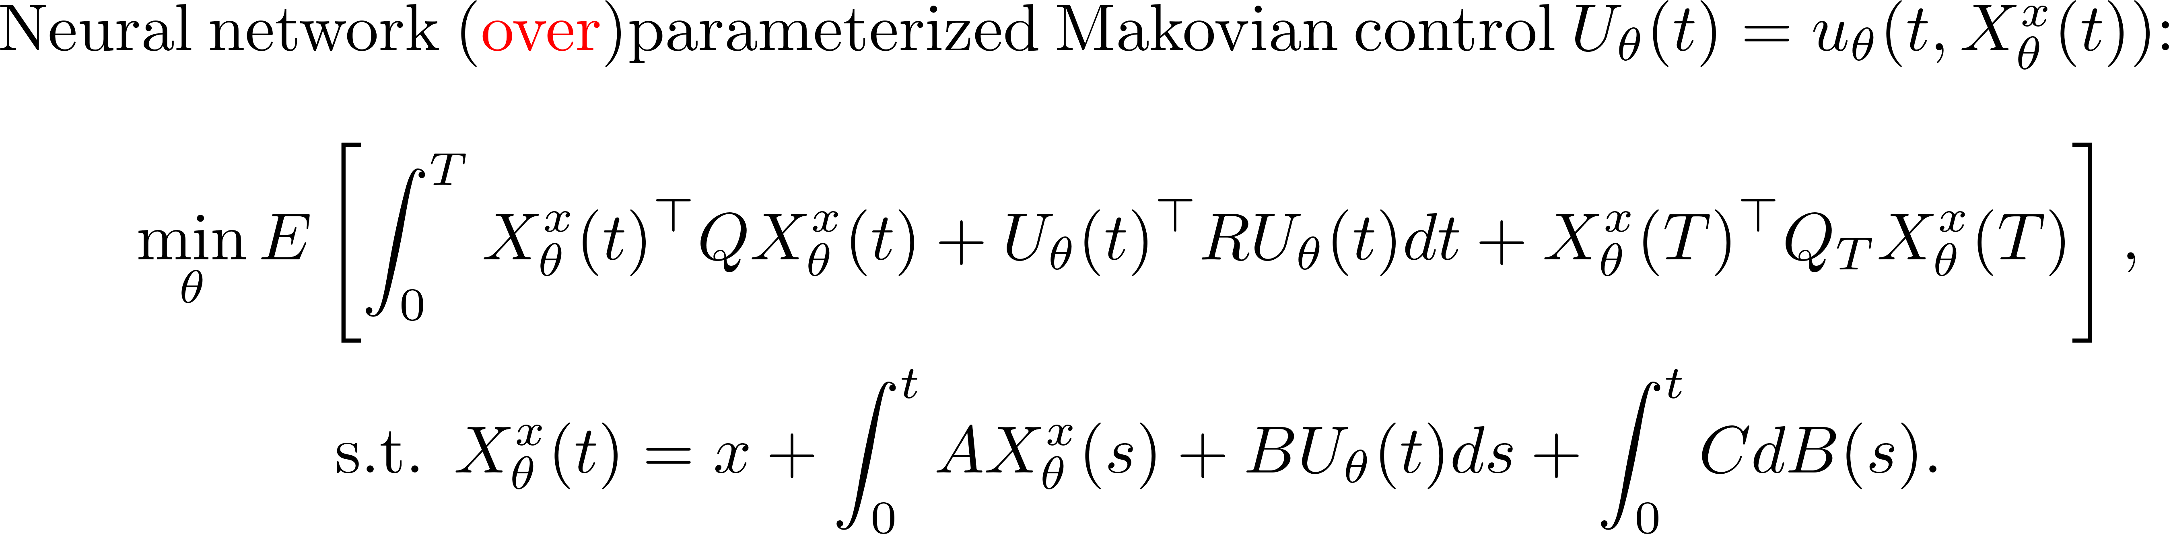
Linear Quadratic Control Example

Slide 19
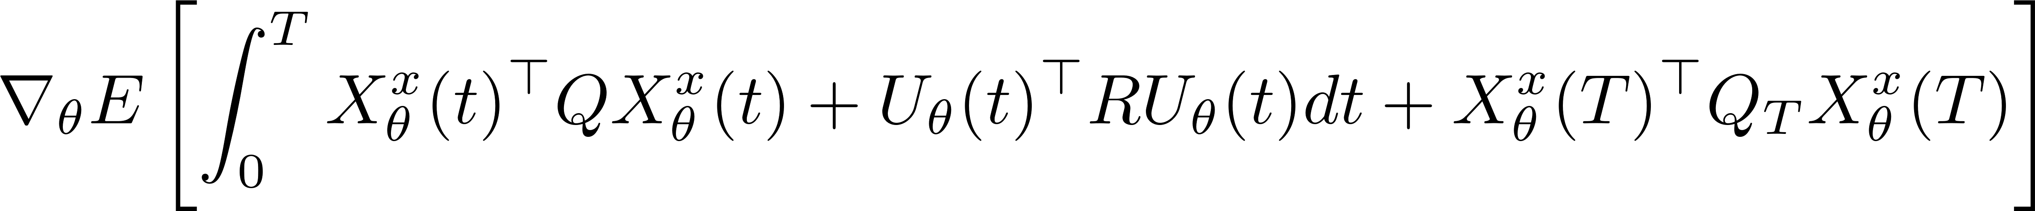
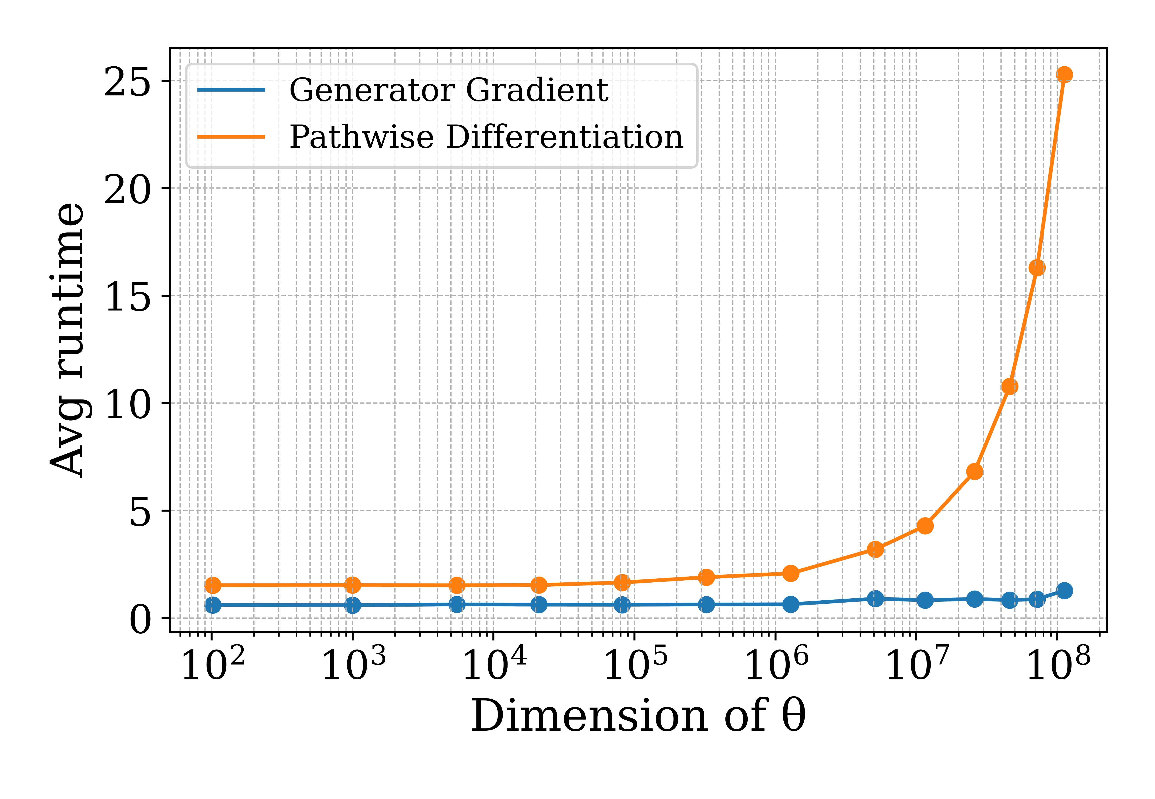

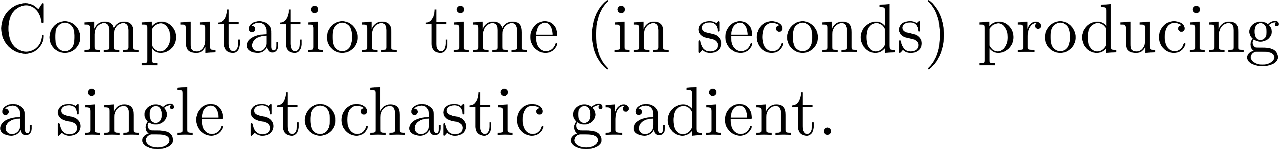
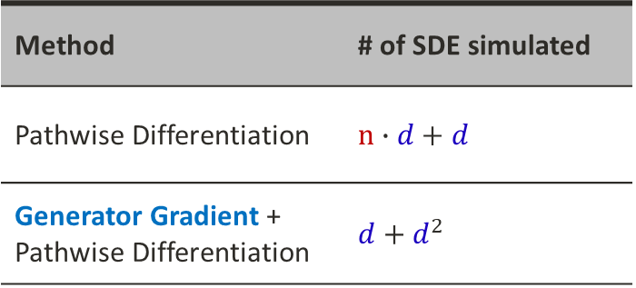
Computation Time Comparison
Method | # of SDE simulated
Pathwise Differentiation | $$n∙d+d$$
Generator Gradient + Pathwise Differentiation | $$d+d^{2}$$

Slide 20
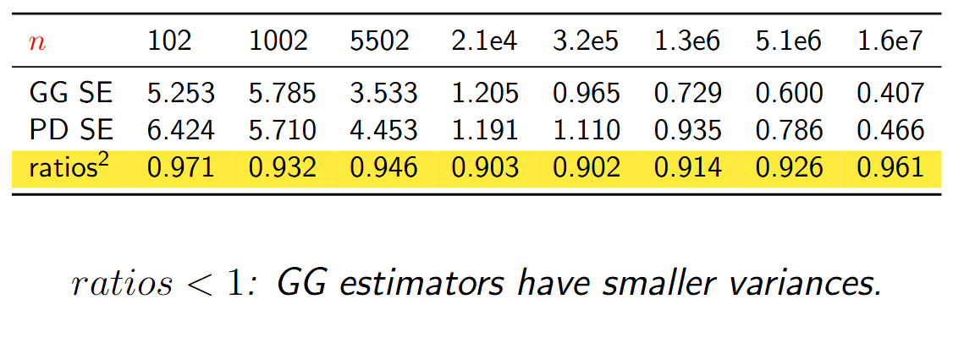
Quality of the Estimators
Compare the sample standard error (400 samples):

Slide 21

Thank You Your questions and thoughts are most welcome!
Paper can be found here

Slide 22
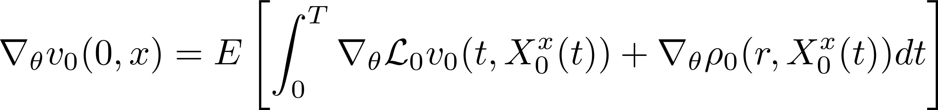
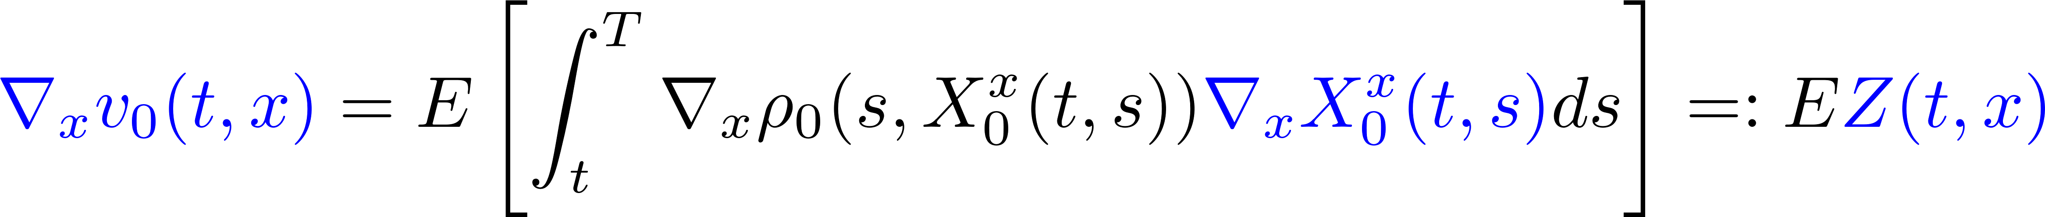

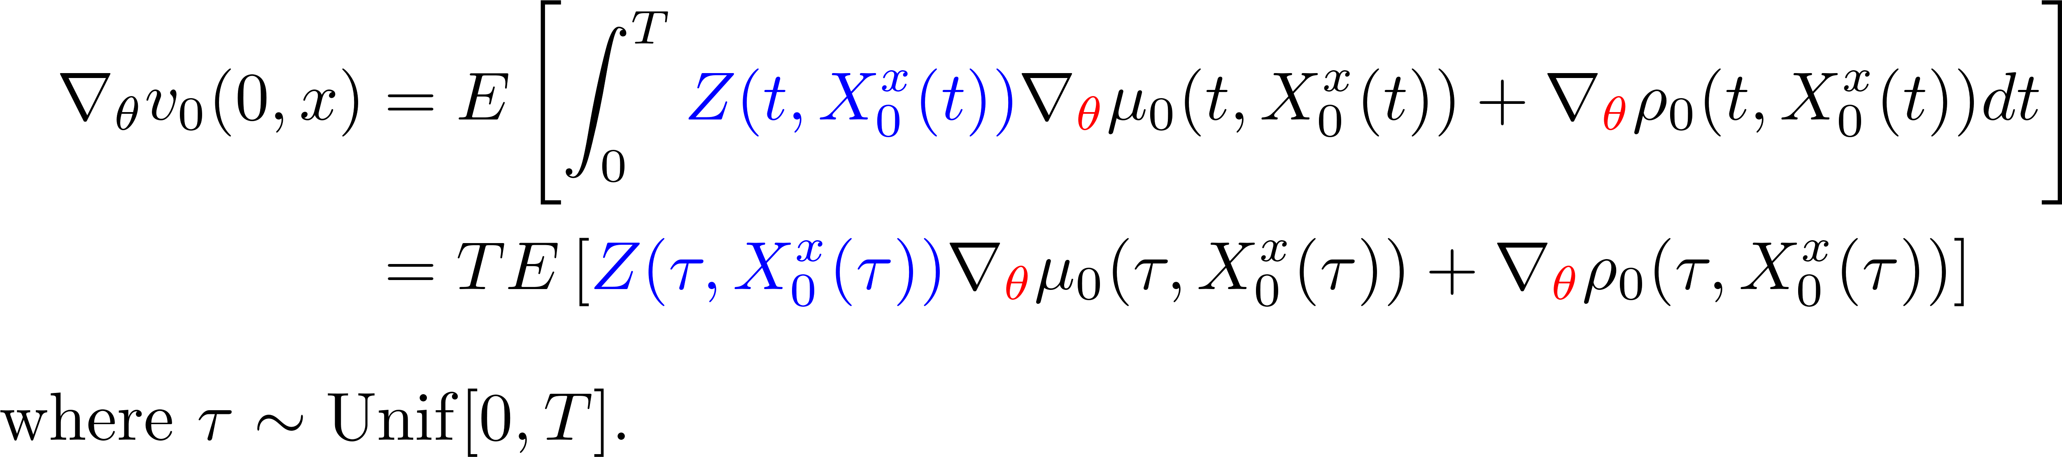
The Generator Gradient Estimator

Slide 23
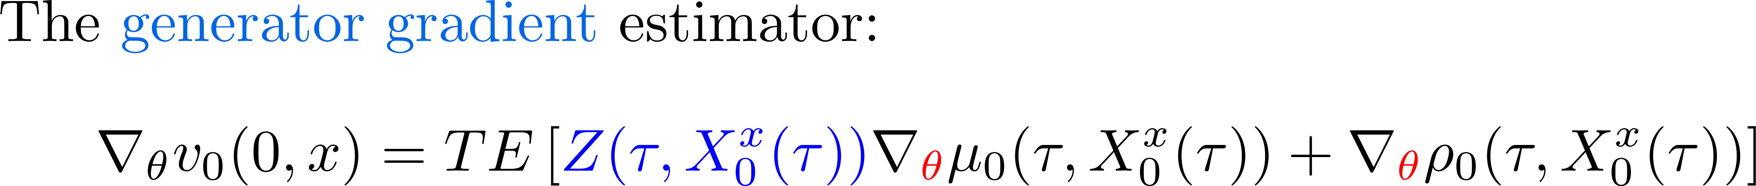
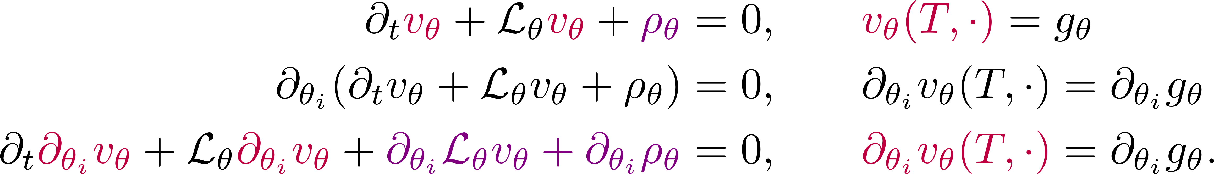
Summary

Slide 24
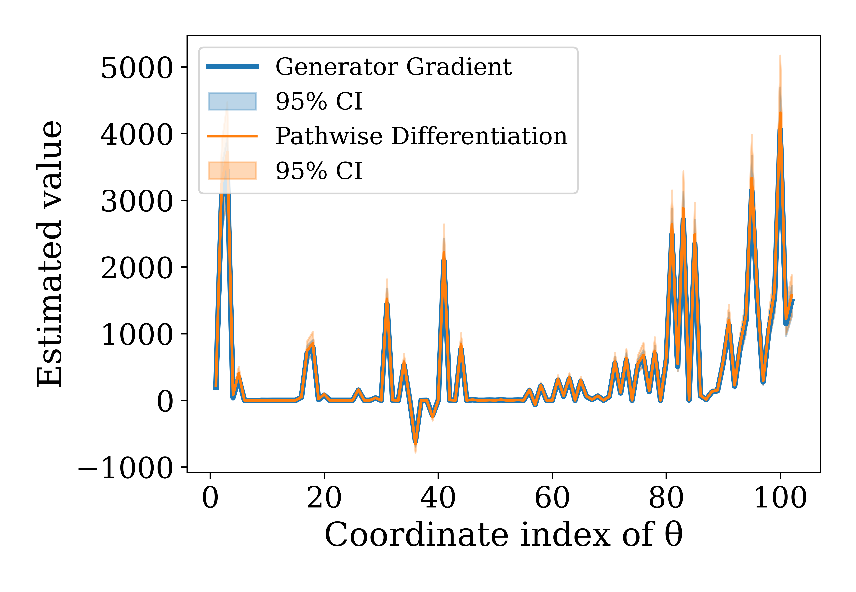
Quality of the Estimators
Compare the estimated gradient values of the estimators:

Slide 25
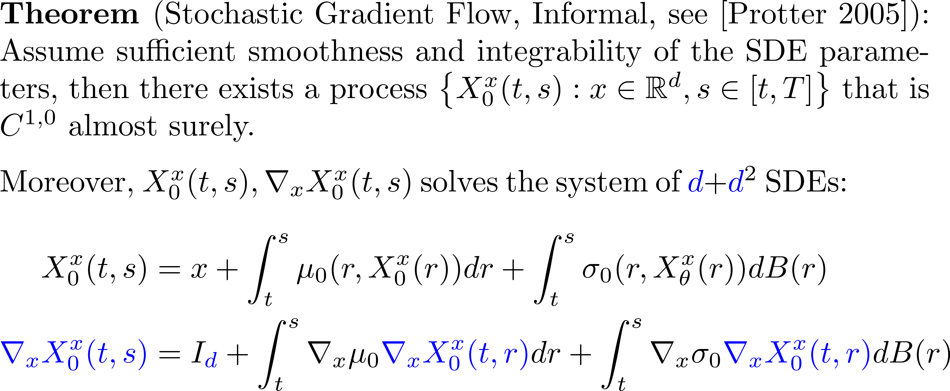
Stochastic Gradient Flow

